Slide 1

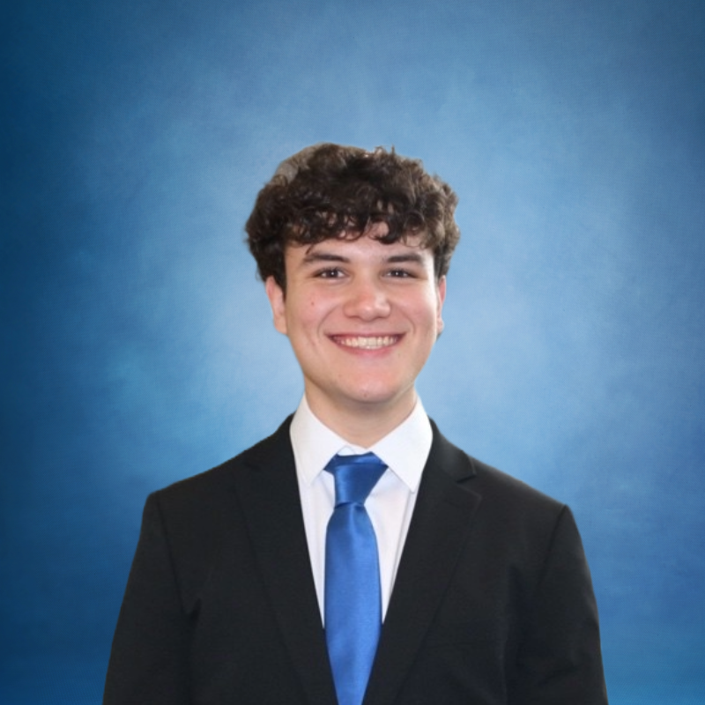
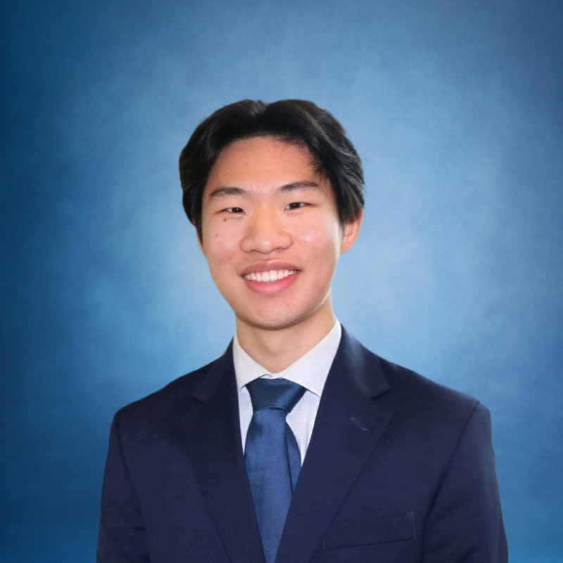
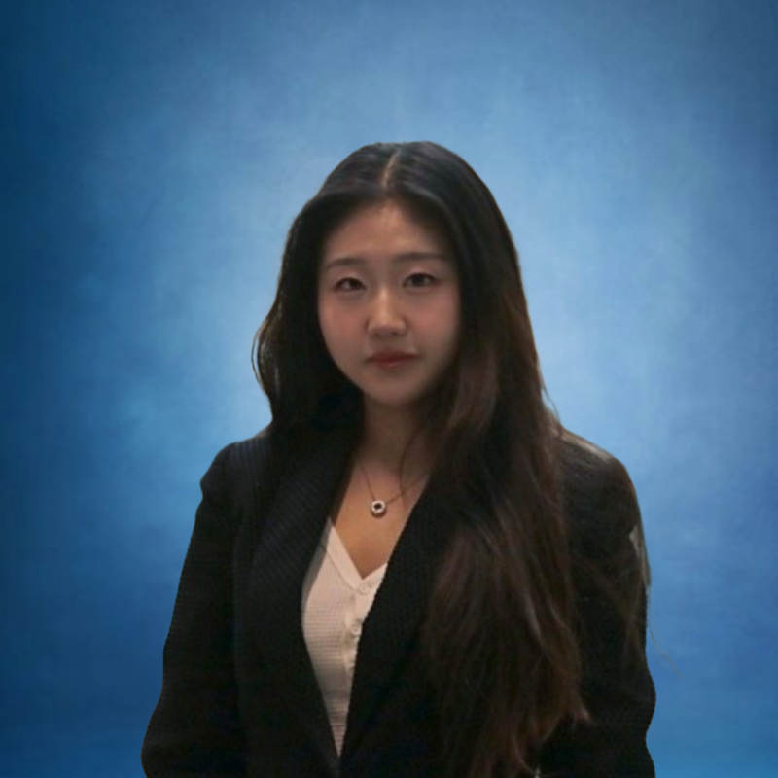
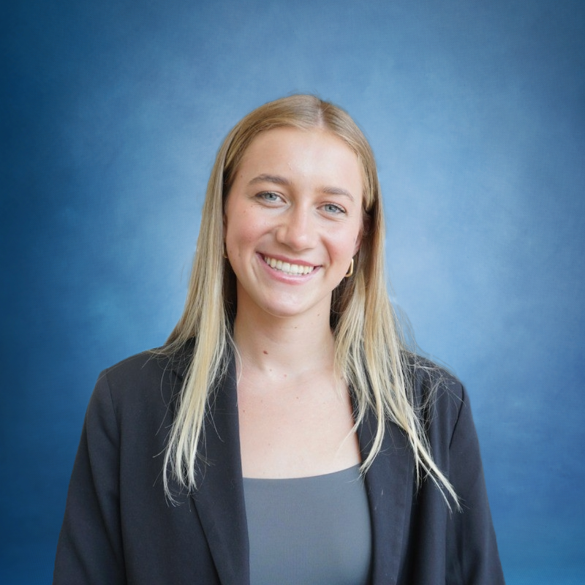
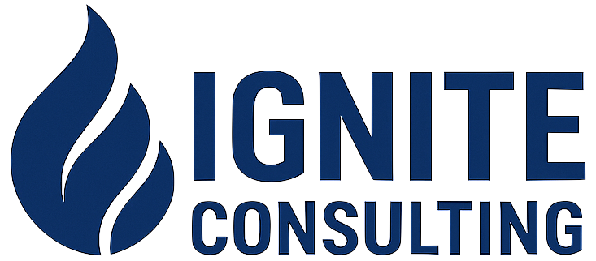
Croonwolter&dros – The InsightX Solution
Becoming an industry leader in the Netherlands
Lucas
Jeffery
Josephina
Erin

Slide 2
Our team was asked to answer the following questions:
Situation Overview
Key Question
How can CWD leverage AI to build long-term competitiveness?
Tasks
1
2
3
How can CWD best utilize AI in its operations?
How can CWD implement AI solutions successfully?
What operational, financial, and strategic steps are needed to execute the strategy?
Complications
Staff shortages and an aging workforce
Decentralized workforce
Previous negative experiences integrating new technologies

Slide 3

An overview of the InsightX approach
Executive Summary
Key Question
How can CWD leverage AI to build long-term competitiveness?
Action Plan: The InsightX approach
INTEGRATE
OPTIMIZE
Focus on internal AI applications with Microsoft Dynamics 365
Introduce the Insight Program to roll out enterprise AI quickly and responsibly
Core Strategic Outcomes
+20% Employee Lifetime Value
€14M Project NPV
>5% EBIT Margin by 2029

Slide 4
Where Should CWD Focus Its AI Vision? Internally or Externally?
McKinsey’s Dual Transformation Model
Build Externally Once Core is Stable
Award
Internally Reinvent the Core
Conservative Nature: If engineers and managers don’t adopt and trust AI internally, it’s difficult to deliver credible AI solutions to clients
5
Create Value Internally: Increase internal productivity and generate tangible metrics and case examples to show clients
A
B
Without Transformation A, Transformation B is difficult
Before CWD can sell AI-powered excellence, it must internalize it

Slide 5
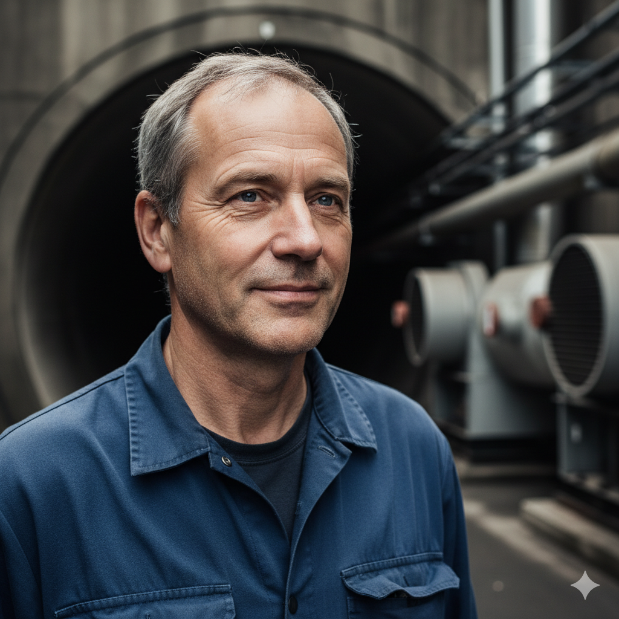
Persona: Engineer Erik Represents the Employees We Can Better Serve
A 55-year-old Infrastructure Engineer symbolizes CWD’s workforce—skilled, loyal, and ready for change.
Customer Profile
Key Aspirations
Frustrations:
Manual Excel logs, paper checklists, no channel to suggest improvements
Mindset:
“I know Excel these systems inside-out, but I’m being left behind
Aspiration
Leave a legacy and mentor young engineers
Engineer Erik
Age: 55
Experience: 27 years
at CWD
Role: Senior Infrastructure Engineer – Tunnel Safety Systems
CWD’s people are ready — they just need direction and tools
Key Insight
94% of employees already use AI in some capacity
(McKinsey 2025)
Takeaway: Employees like Erik are ready for responsibly innovation and change
5

Slide 6
What Are Our Current Roadblocks with AI and How Do We Address Them?
Alternative Solutions Analysis
Potential Solutions
SAP S/
4HANA
Oracle Fusion Cloud
Build In-House
IBM Watsonx
Microsoft Dynamics 365
Current AI Roadblocks
Poor Data Quality & Processes
Ease of Data Integration and Cleaning
Integrate into legacy systems
Fragmented Legacy Systems
Ease of Use/ Employee Adoption
Difficulty to Use and Low Adoption
Scalability and Governance
Takeaway: Microsoft Dynamics 365 best addresses CWD’s current AI roadblocks

Slide 7
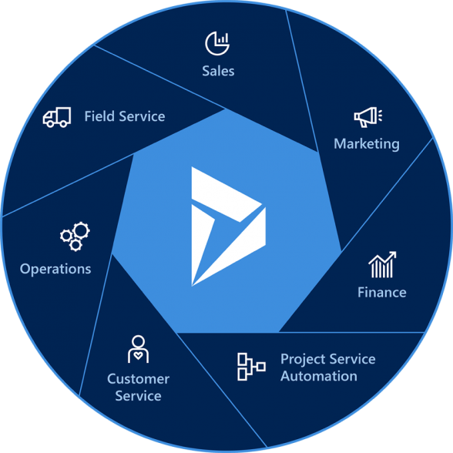
Microsoft Dynamics 365: The Digital Core for CWD’s AI Transformation
What it is
Key Features
Benefits
Integration: Connects legacy systems through Boomi
Fragmented Legacy Tools → Unified on one ERP/CRM platform
1
Copilot AI Assistant: Automates manual tasks and acts as tool
Manual Workflows → Automated through AI copilots
2
Real-Time Dashboards: KPIs on efficiency, uptime, and costs
A unified cloud platform that integrates and enables automation, real-time analytics, and AI-driven decision-making
Productivity and AI Adoption → Central dashboards showing real-time metrics
3
Scalable Cloud Infrastructure: Secure and flexible
Takeaway: Dynamics 365 provides CWD with a single, AI-enabled digital platform to drive measurable productivity and future growth
7

Slide 8
Introducing Microsoft Dynamics 365 — The Digital Core for CWD’s AI Transformation
What it is
Key Features
Benefits
Integration: Connects legacy systems through Boomi
Fragmented Legacy Tools → Unified on one ERP/CRM platform
Case Study: Dynamics 365 Client
A manufacturing firm used Dynamics 365 to replace fragmented systems, manual processes, and poor data visibility with a unified ERP and AI-driven analytics
Result: +40% productivity and +25% revenue growth within a year
1
Copilot AI Assistant: Automates manual tasks and acts as tool
Manual Workflows → Automated through AI copilots
2
Real-Time Dashboards: KPIs on efficiency, uptime, and costs
A unified cloud platform that integrates enables automation, real-time analytics, and AI-driven decision-making
Productivity and AI Adoption → Central dashboards showing real-time metrics
3
Scalable Cloud Infrastructure: Secure and flexible
Takeaway: Dynamics 365 provides CWD with a single, AI-enabled digital platform to drive measurable productivity and future growth
8

Slide 9


Engineer Erik’s Journey – Identifying Internal Barriers to AI Adoption
Customer Analysis
No coordinated data system
No channel to share AI or automation ideas
Customer Profile
Implement Microsoft Dynamics 365
How can CWD collect and assess AI ideas safely?
Little engagement with AI team
How can engineers and the AI team collaborate better?
Engineer Erik
Lack of cross-functional knowledge sharing
How can CWD share AI learnings across divisions?
Limited training on new tech
Age: 55
Experience: 27 years
at CWD
Role: Senior Infrastructure Engineer – Tunnel Safety Systems
How can CWD upskill and retain experienced staff?
9

Slide 10
InsightX
Becoming an Industry Leader in the Netherlands
INTEGRATE
Key Takeaways
 | Focus on Internal AI
How can CWD best utilize AI in its operations?
 | Understand Current Digital Situation
Focus on internal AI applications with Microsoft Dynamics 365
 | Implement Dynamic 365
Notes:
Bucket intro slide (1/2)

Slide 11
Building a Responsible AI Foundation for CWD
Adopting HBR’s OPEN Framework to guide innovation and governance
Key Analysis
Implementation – The OPEN Framework
CWD manages critical infrastructure - innovation errors can be catastrophic.
An HBR framework for innovating and scaling AI responsibly
1
Outline:
Define the purpose of AI initiatives
Examples:
Smart grids: citywide blackouts
Water systems: contamination risks
Rail control: collisions
2
Partner:
Collaborate across functions and with external partners
3
Experiment:
Run small, structured pilots to learn quickly and fail safely
Enable safe, consistent, and value-driven AI adoption across CWD
AI should not be deployed independently by untrained teams
Navigate:
Scale successful pilots and continuously adjust based on feedback
4
The OPEN Framework enables CWD to innovate confidently—balancing experimentation with the safety and reliability required in critical infrastructure.
11

Slide 12
Introducing Project INSIGHT
A structured approach to enable safe, scalable AI innovation across CWD.
Outline
Partner
Experiment
Navigate
Create an INSIGHT Engine, an online Dropbox for teams to submit AI application ideas
Select 1 project from each division and embed an AI engineer within the team
Run the pilot project with continuous feedback to the embedded AI engineer
Scale successful pilots across divisions through quarterly INSIGHT Showcases
Key Takeaway: Project INSIGHT uses HBR’s OPEN Framework to make AI adoption structured, safe, and people-driven — turning CWD’s craftsmanship into continuous innovation.

Slide 13
Engineer Erik’s Journey – Identifying Internal Barriers to AI Adoption
Customer Analysis
No coordinated data system
No channel to share AI or automation ideas
Customer Profile
Implement Microsoft Dynamics 365
How can CWD collect and assess AI ideas safely?
Little engagement with AI team
How can engineers and the AI team collaborate better?
Engineer Erik
Lack of cross-functional knowledge sharing
How can CWD share AI learnings across divisions?
Limited training on new tech
Age: 55
Experience: 27 years
at CWD
Role: Senior Infrastructure Engineer – Tunnel Safety Systems
How can CWD upskill and retain experienced staff?
13

Slide 14
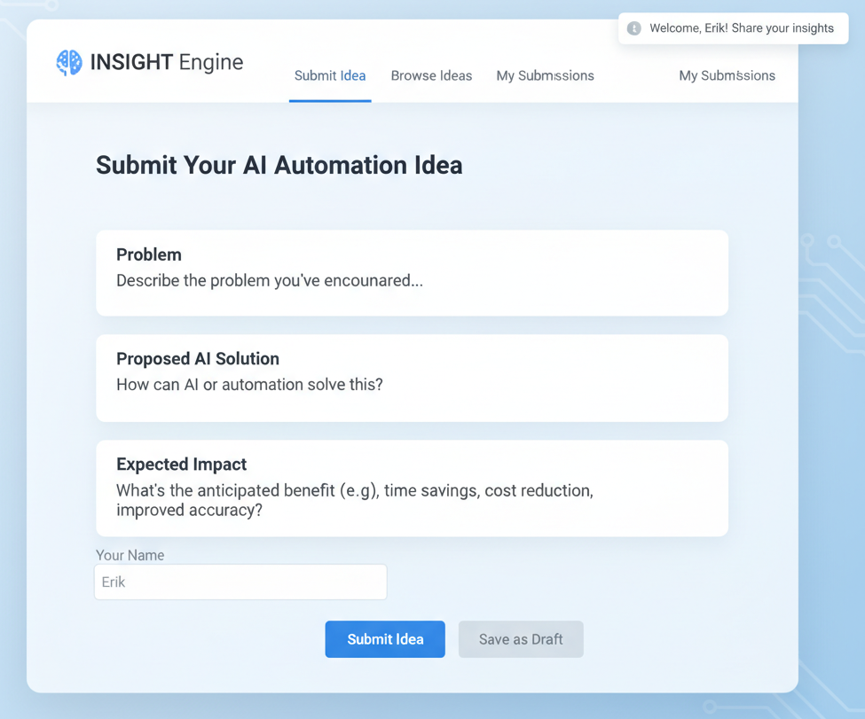
O | Outline – Create the INSIGHT Engine
Turning employee ideas into structured, purpose-driven innovation.
Description
1
What is it?
The INSIGHT Engine is an internal online platform for any employees to submit an AI-use case idea
2
Erics Submission:
“Use AI to scan IoT sensor data and predict ventilation fan malfunctions before they occur.”
3
Submissions will be evaluated on:
Feasibility (technical and data availability
Impact (time savings, safety improvement, energy efficiency)
Alignment (CWD’s mission: Intelligence through Technology)
The INSIGHT Engine turns employee frustration into focused, data-driven innovation opportunities.
14

Slide 15
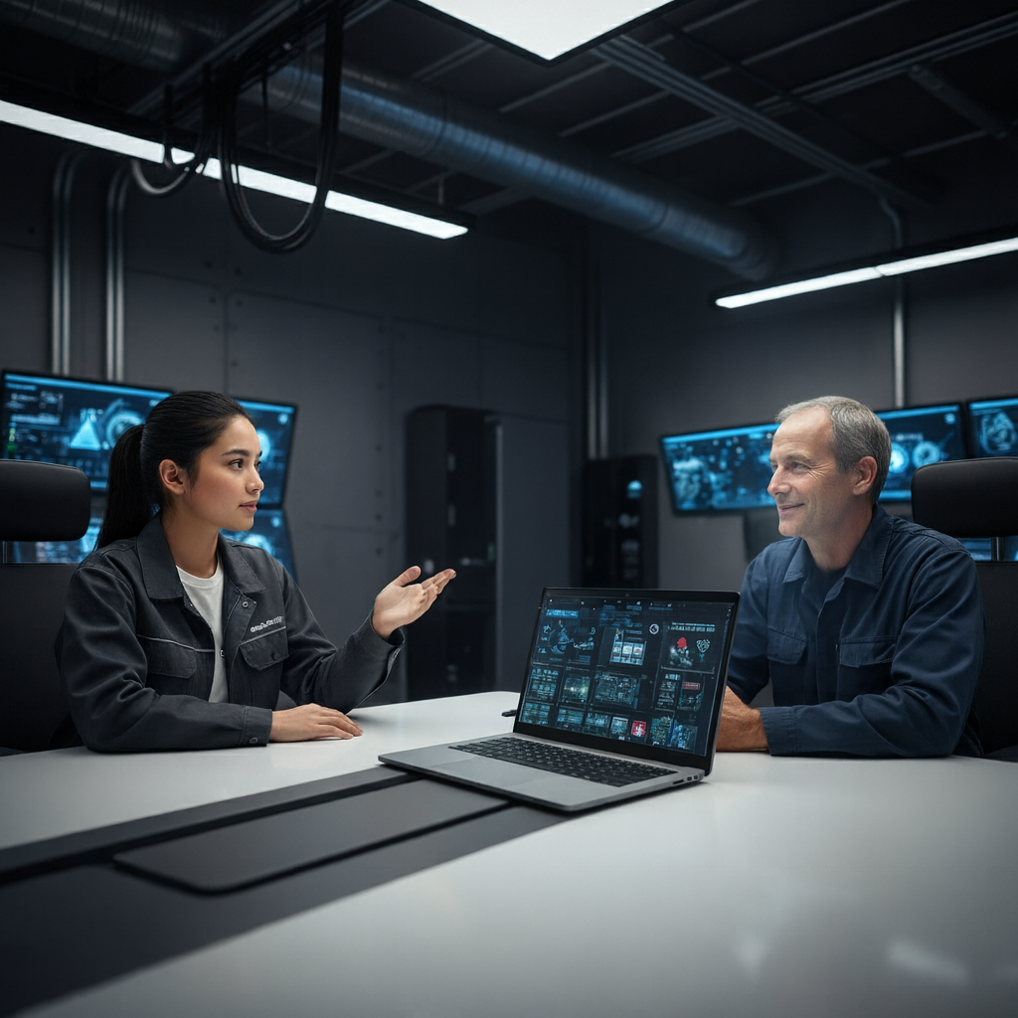
P | Partner – Embed AI Engineers in Each Division
Pairing field expertise with digital intelligence
Description
1
Selection:
The AI Office selects one top idea per division (Infra, Industry, Utility) each quarter.
Case Study: Intuit
Embedding AI engineers directly in product teams improved productivity by 15% (HBR 2025)
2
Create Cross Functional Team:
Each pilot team is composed of 1 embedded AI engineer, field engineers, and an executive sponsor
3
Responsibilities:
The AI engineer handles model development; Erik’s team provides field data and real-world insight
4
Collaboration:
Collaboration builds mutual understanding – AI is a tool, not a threat
Embedding AI experts with engineers merges domain knowledge and technical capability - CWD’s true competitive edge
15

Slide 16
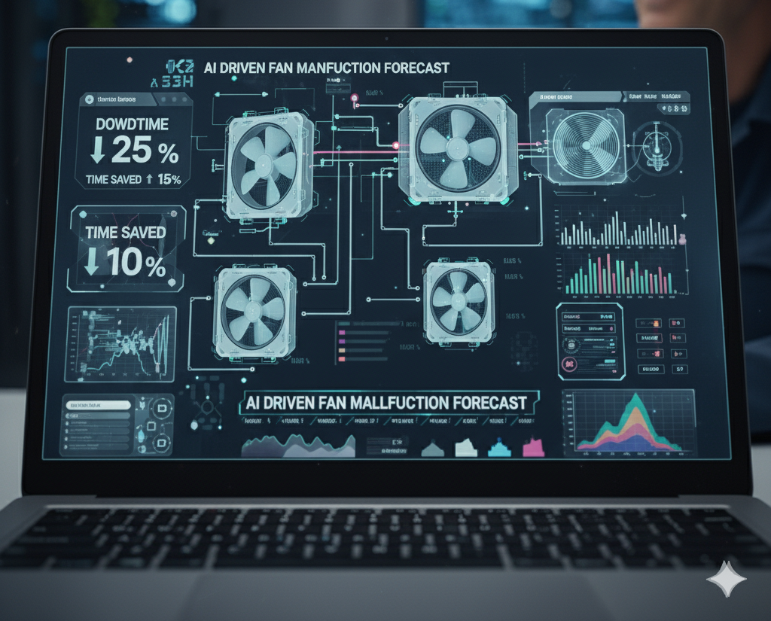
E | Experiment – Run Safe, Measurable Pilots
Test fast, learn safely, and deliver measurable results.
What it is
Description
Erik’s Experience
Focus on small, controlled experiments with clear KPIs.
The pilot predicts fan malfunctions a week before failure - saving 15% maintenance hours and improving safety
Weekly progress updates between Erik’s team and the AI engineer.
Feedback loop ensures models are practical and understandable.
Pilots run 12 weeks
Builds confidence through early success - not abstract theory.
Takeaway: Safe, small-scale pilots build trust in AI and prove tangible value early.
16

Slide 17
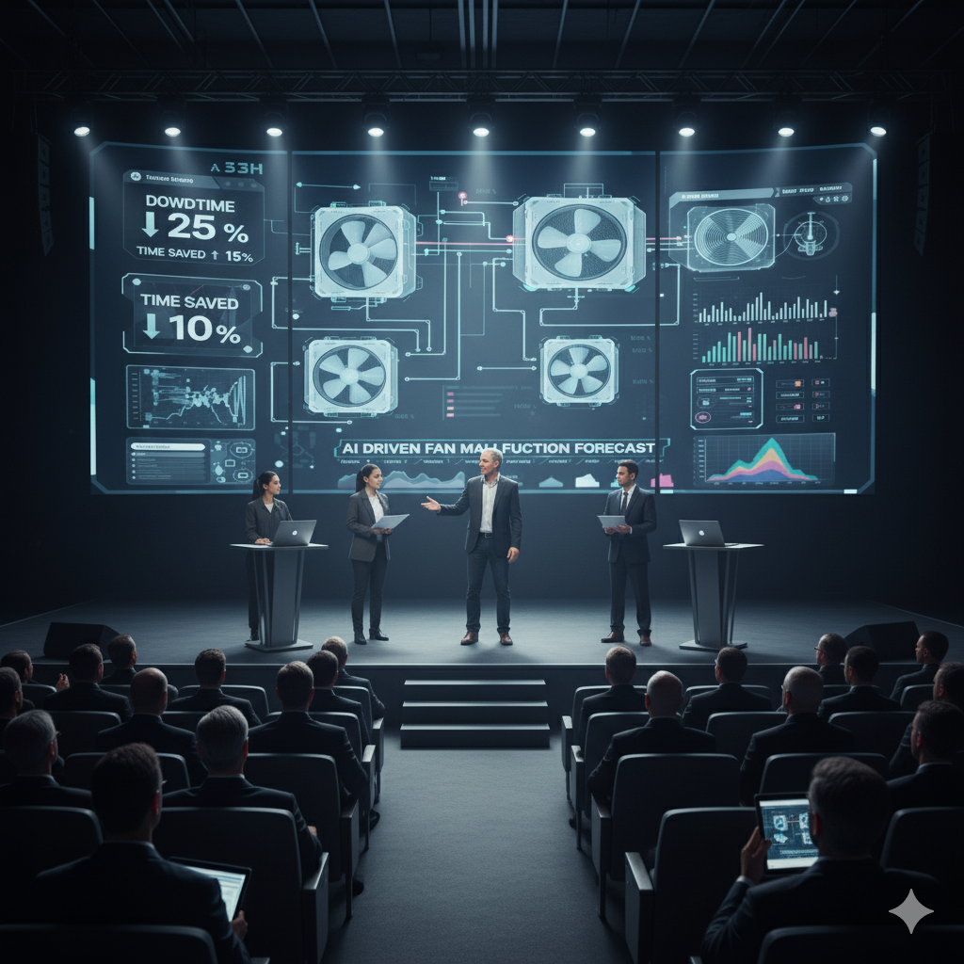
N | Navigate – Scale and Share Learnings through INSIGHT Showcases
Turning pilot success into continuous improvement across CWD
INSIGHT Showcases:
Description:
Quarterly cross-functional events where pilot project teams present results, live demos, and key learnings to peers
Successful pilots are standardized into the CWD AI Module Library - a central repository enabling reuse, faster deployment, and continuous improvement.
Erik’s predictive maintenance pilot wins Most Impactful Project - now part of the AI Library and may be scaled to the entire Industry division
INSIGHT Showcases institutionalizes innovation - transforming one engineer’s idea into enterprise-wide improvement.
17

Slide 18
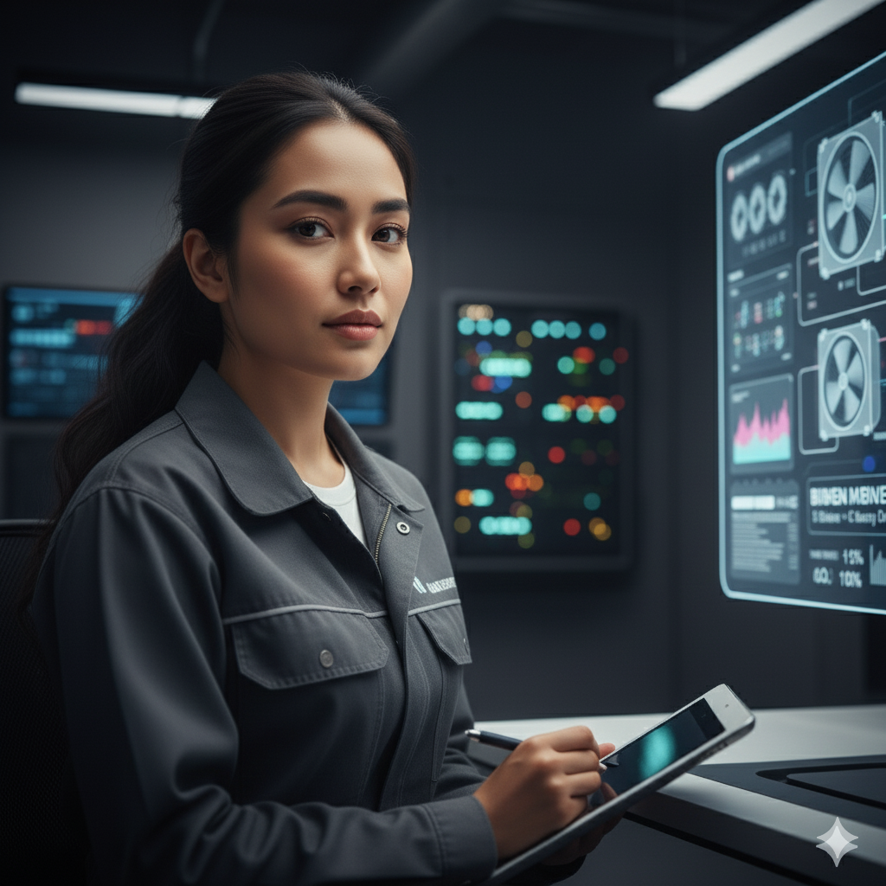
CWD Talent Recruitment and Mentionship Program
Pairing veteran engineers with young recruits to preserve craftsmanship and build digital fluency.
Recruitment:
Attend university STEM related events at top Dutch universities and showcase advances in technology and cutting-edge AI projects to attract new talent
Mentor
What you need to get there
Mentee
System logic and tunnel safety protocols
1
System logic and tunnel safety protocols
1
Hands-on troubleshooting and risk management
2
Hands-on troubleshooting and risk management
2
1
Data analytics and automation basics
2
Modern collaboration tools (Teams, Power BI)
Takeaway: Both generations upskill — bridging craftsmanship and coding.

Slide 19
Engineer Erik’s Journey – Identifying Internal Barriers to AI Adoption
Customer Analysis
No coordinated data system
No channel to share AI or automation ideas
Customer Profile
Implement Microsoft Dynamics 365
Create a digital dropbox
Little engagement with AI team
Embed AI Engineers
Engineer Erik
Lack of cross-functional knowledge sharing
Create Townhalls
Limited training on new tech
Age: 55
Experience: 27 years
at CWD
Role: Senior Infrastructure Engineer – Tunnel Safety Systems
Add mentorship sessions
19

Slide 20
CWD INSIGHT
Becoming an Industry Leader in the Netherlands
OPTIMIZE
Key Takeaways
 | Create a responsible AI-development pipeline using INSIGHT Engine
How can CWD implement AI solutions successfully?
 | Embed AI developers in teams and create quarterly townhalls
Introduce the Insight Program to roll out enterprise AI quickly and responsibly
 | Foster new skill development through mentorship programs
Notes:
Bucket intro slide (1/2)

Slide 21
What can we be doing in the next 10+ years to propel CWD
Implementation plan
LAUNCH
BUILD
EXPAND
1.5 Years
3.5 Years
5 Years +
Clean all company data
Launch AI Insight Training Program
Integrate all data into Microsoft Dynamics 365
Outsource cyber security support
Launch Microsoft Dynamics 365
Launch the Insight Engine and monthly sessions
Launch the Insight Recruitment Plan
Launch the Insight Mentorship Program
Scale AI team from 4 to 12 employees
Launch technical services Insight AI expansion

Slide 22
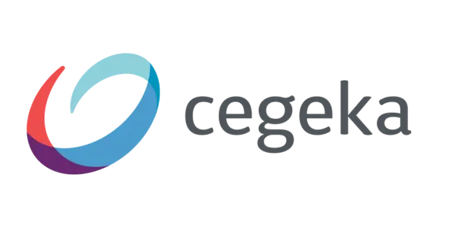

What can we be doing in the next 10+ years to propel CWD
Implementation plan
LAUNCH
BUILD
EXPAND
1.5 Years
3.5 Years
5 Years +
Launch Microsoft Dynamics 365
1.5 years
Data Cleaning: To be performed by the AI team
Integration and launch: To be supported by an outsourced implementation partner
Clean all company data
Launch AI Insight Training Program
Integrate all data into Microsoft Dynamics 365
Outsource cyber security support
Launch Microsoft Dynamics 365
Launch the Insight Engine and monthly sessions
Launch the Insight Recruitment Plan
Launch the Insight Mentorship Program
Scale AI team from 4 to 12 employees
Launch technical services Insight AI expansion

Slide 23
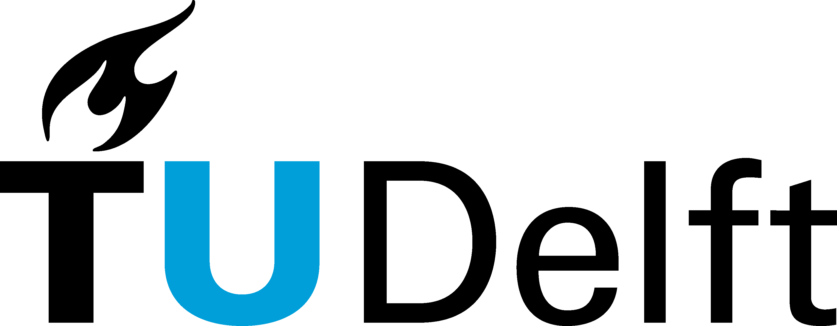


What can we be doing in the next 10+ years to propel CWD
Implementation plan
LAUNCH
BUILD
EXPAND
1.5 Years
3.5 Years
5 Years +
Launch the AI Insight Training Program
3.5 Years
Training Sessions: 2 virtual teaching sessions taught by the AI team and outsourced implementation partner.
Technical Support: To be provided by outsourced implementation support.
Additional Support: To be provided through the Insight Mentorship Program.
Clean all company data
Launch AI Insight Training Program
Launch the Insight Recruitment Plan
3.5 Years
Recruiting events attended: 6 each year
Integrate all data into Microsoft Dynamics 365
Outsource cyber security support
Launch Microsoft Dynamics 365
Launch the Insight Engine and monthly sessions
Launch the Insight Recruitment Plan
Launch the Insight Mentorship Program
Scale AI team from 4 to 12 employees
Launch technical services Insight AI expansion

Slide 24
What can we be doing in the next 10+ years to propel CWD
Implementation plan
LAUNCH
BUILD
EXPAND
1.5 Years
3.5 Years
5 Years +
Calm’s Mission: “Calm’s mission is to support everyone on every step of their mental health journey.” KPI
Launch AI Insight Training Program
Clean all company data
Outsource cyber security support
Launch technical services Insight AI expansion
5+ Years
Launch the Insight Engine and monthly sessions
Integrate all data into Microsoft Dynamics 365
Priority 1: Residential Construction
Launch the Insight Recruitment Plan
Priority 2: Utilities
Launch Microsoft Dynamics 365
Priority 3: Infrastructure
Launch the Insight Mentorship Program
Scale AI team from 4 to 12 employees
Takeaway: Residential Construction offers the joint highest market size, best AI opportunities, and strongest internal fit with CWD.
Launch technical services Insight AI expansion

Slide 25
The InsightX solution is prepared for future hurdles
Risk and Contingencies Analysis
Risk Assessment Matrix
Risk
Mitigation
1
Aging workforce isn’t willing to adopt new technology
Training and mentorship with younger employees
1
2
Impact
2
Integration complexity
High
Phased implementation with constant feedback loops
3
3
Poor data quality reducing productivity gains
Data Quality Audits for any data that is being entered into the new system
Low
Probability
High

Slide 26



Understanding the impact of the InsightX approach
Summary of outcomes
Drivers
Key Performance Indicators
+20% Employee Productivity
+20%
Employee Lifetime Value
80% Adoption after 5 years
€14M
Project NPV
25% Decrease in Employee Onboarding time
€5.5M Migration and Implementation Cost
>5%
EBIT Margin by 2029

Slide 27
An overview of the InsightX approach
Executive Summary
Key Question
How can CWD leverage AI to build long-term competitiveness?
Action Plan: The InsightX approach
INTEGRATE
OPTIMIZE
Focus on internal AI applications with Microsoft Dynamics 365
Introduce the Insight Program to roll out enterprise AI quickly and responsibly
Core Strategic Outcomes
+20% Employee Lifetime Value
€14M Project NPV
>5% EBIT Margin by 2029

Slide 28
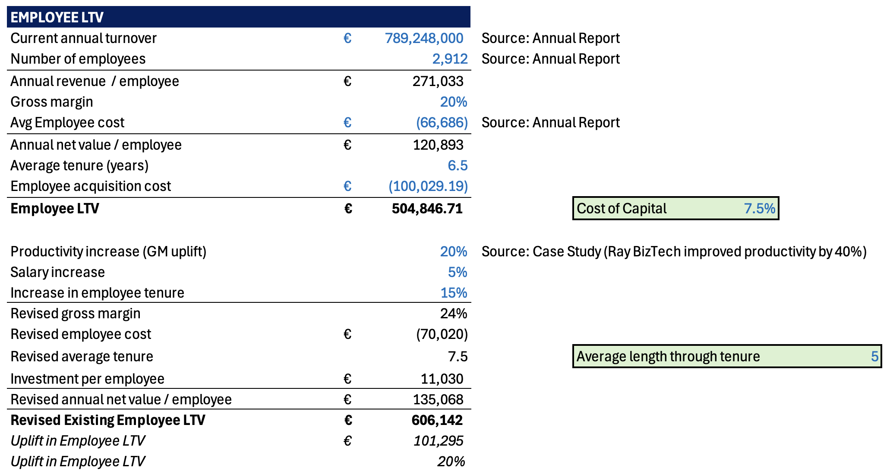
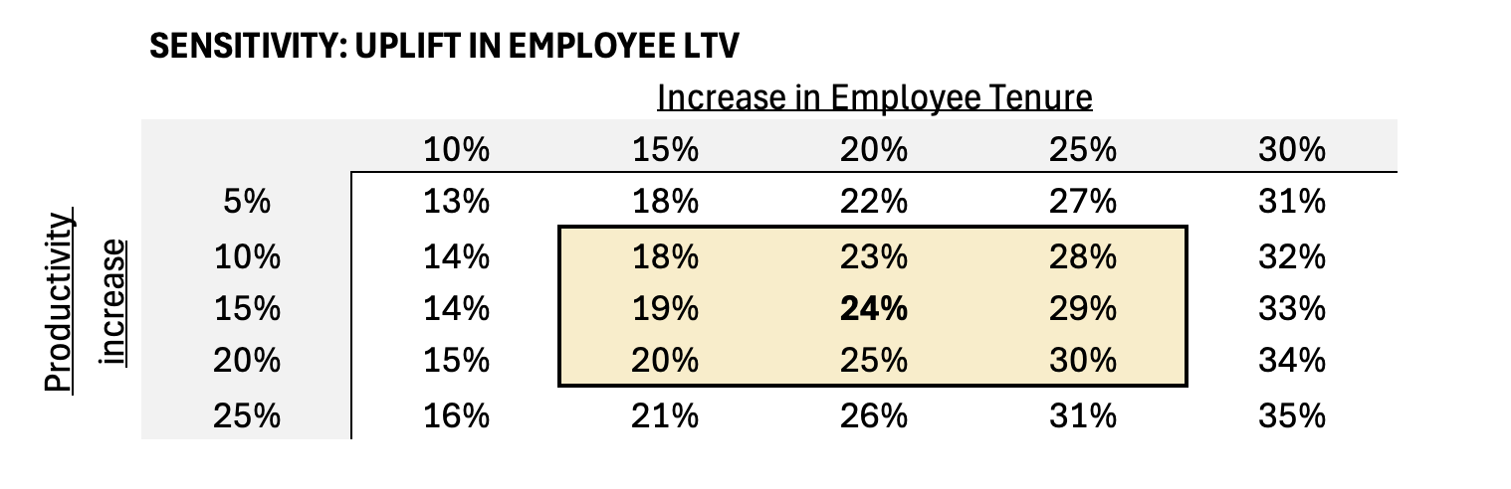
Employee Lifetime Value Model
Appendix A

Slide 29
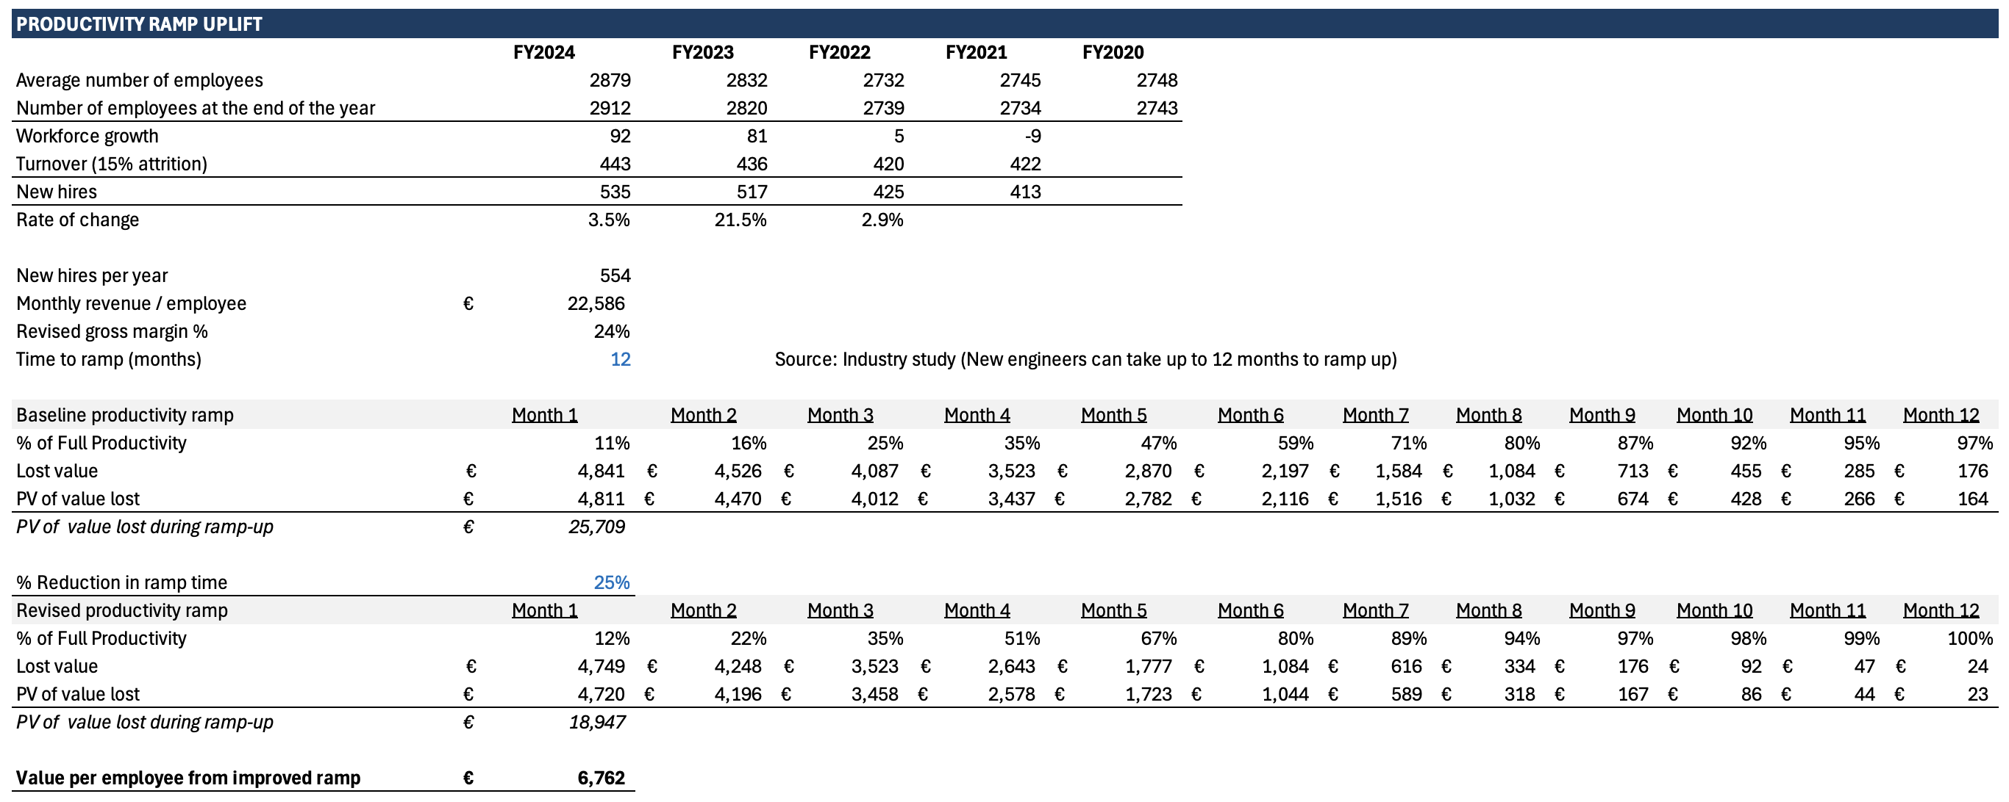
Productivity Ramp Model
Appendix B

Slide 30
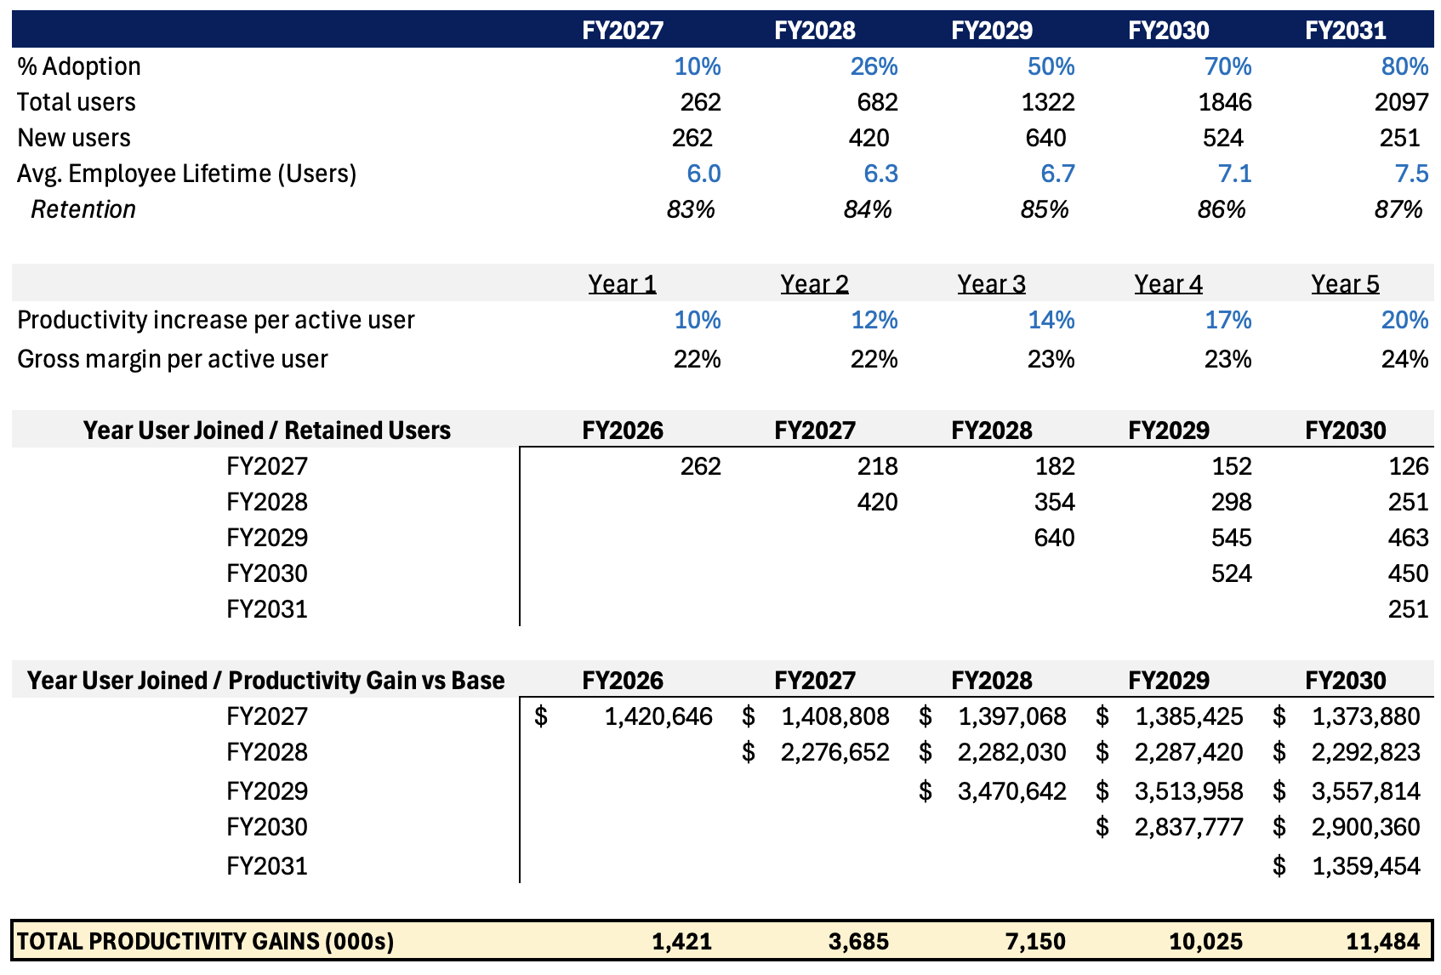
Productivity Gain Model
Appendix C

Slide 31
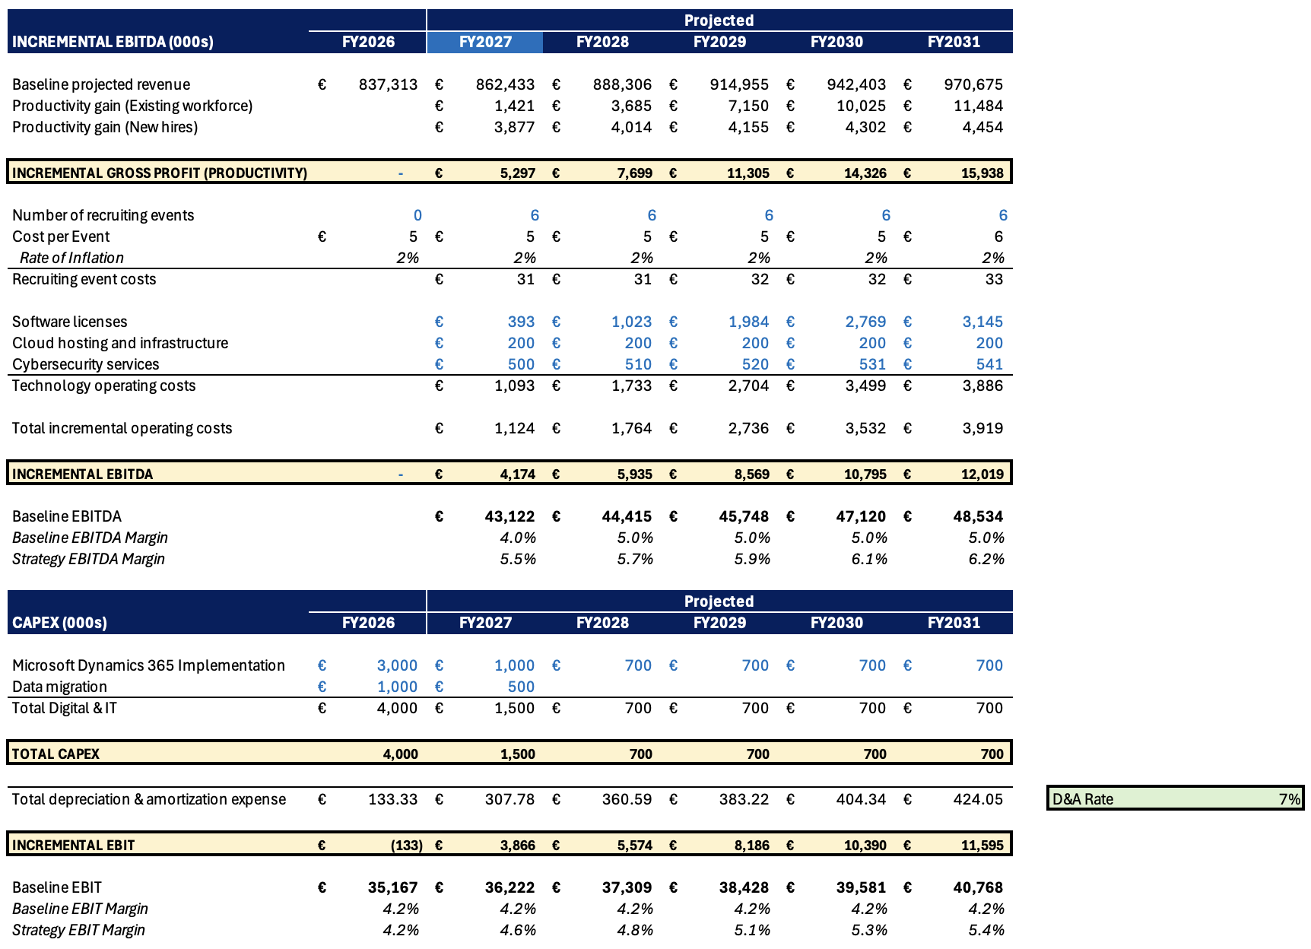
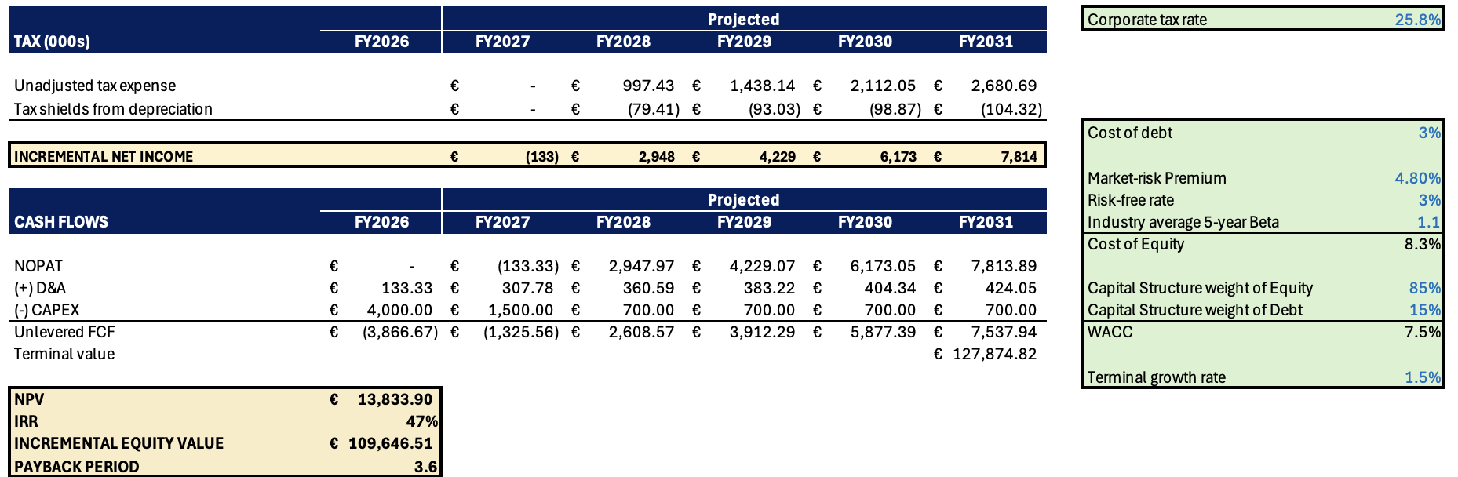
Operating Model
Appendix D

Slide 32
Considering which technical service’s market is best for CWD
Alternative Solutions Analysis
Decision Criteria
Technical Services Market
2026E
Market Size
AI Opportunities
Internal Capabilities
Residential Construction
Priority 1
Utilities
Priority 2
Infrastructure
Priority 3
Takeaway: Joint highest market size, strong AI opportunities in efficiency gains in building management and preparation of job quotes, and best internal fit confirm the residential construction market as the top priority for AI expansion.

Slide 33



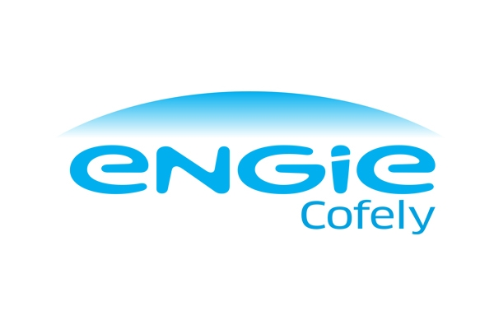

AI Landscape
Competitor Analysis
Competitor Analysis (AI Adoption vs. Market Share)
Market Share
AI Adoption

